Slide 1
Winning parking reform campaigns: Lessons from DC zoning & parking cash-out
Railvolution
October 21, 2021
Cheryl Cort
Policy Director
Coalition for Smarter Growth
Notes:
Layout for title page.

Slide 2
About the Coalition for Smarter Growth
The Coalition for Smarter Growth, the leading non-profit organization in the Washington, D.C. region advocating for walkable, bikeable, inclusive, transit-oriented communities as the most sustainable and equitable way for the DC region to grow and provide opportunities for all.

Slide 3
Why DC is ripe for parking reforms
It’s a city-state (but no votes on Congress!)
36% of households: no access to a vehicle
18% walk/bike to work rate highest in US
Top transit system & ridership
TOD/walk/bike policy priority/innovation
Pre-tax transit benefits (2013)

Slide 4
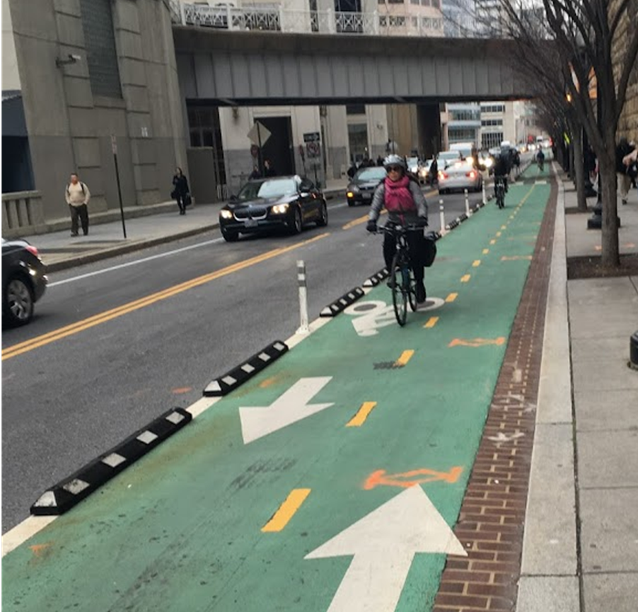
Two big District of Columbia parking reform campaigns
Zoning Update: 2008 – 2016
Parking cash-out: 2017 - 2020
Source: Census

Slide 5
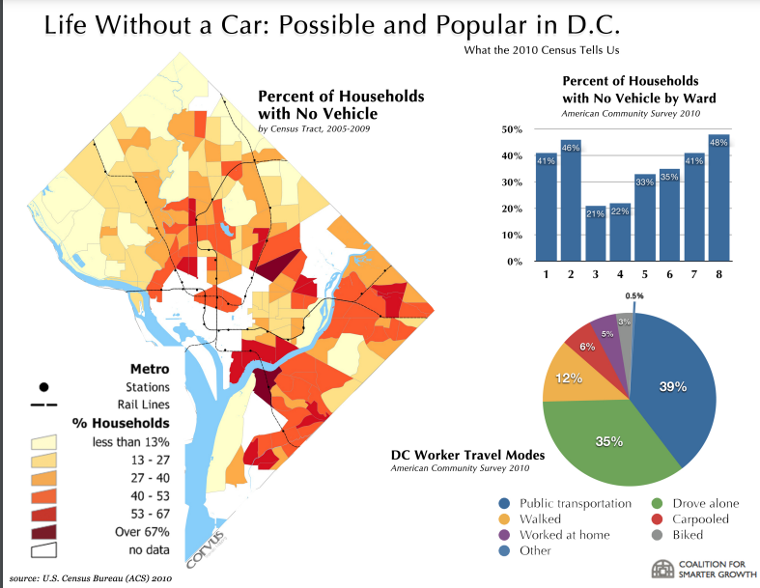
DC Zoning update campaign
3 issues:
Parking requirements
Accessory Dwelling Units (ADUs)
Corner Stores

Slide 6
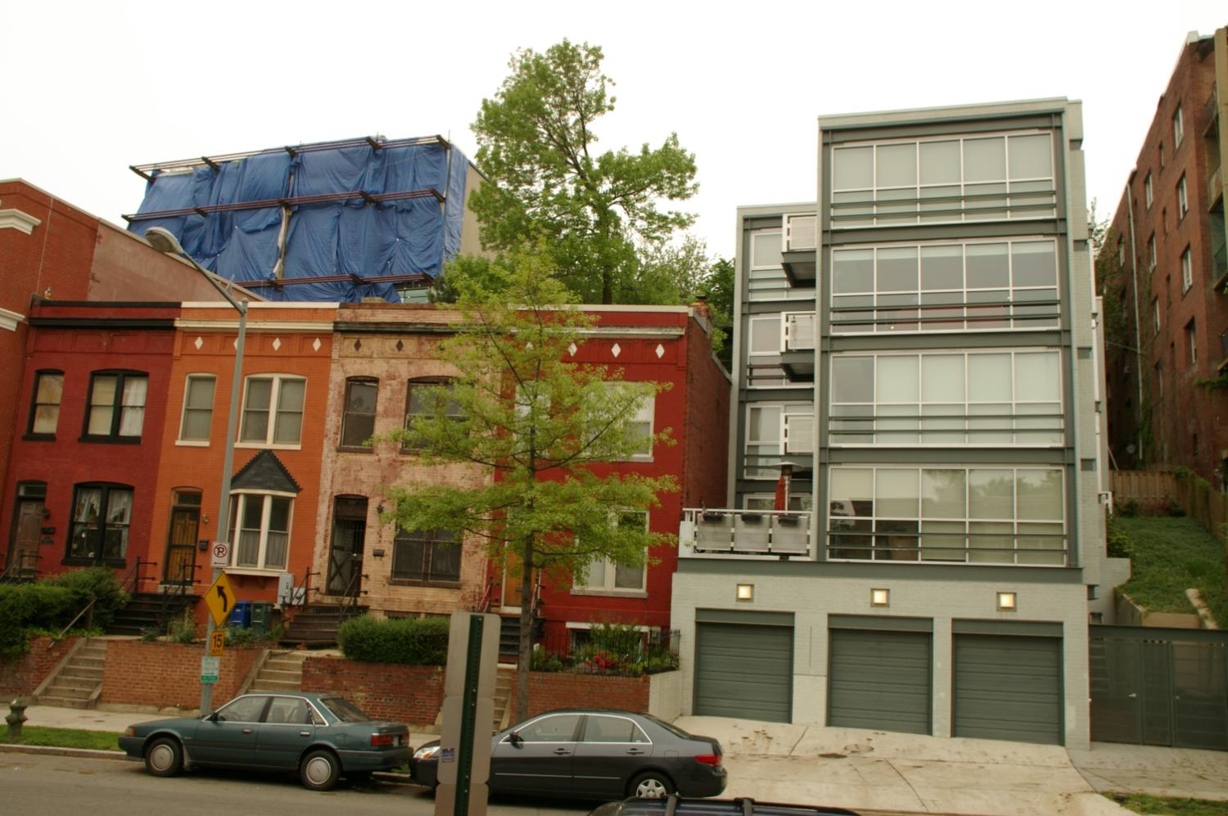
DC Zoning update campaign
Mobilization Goals
Educate public & decision-makers
Recruit diverse group of residents to speak out
Partner with groups
Tools & metrics
Office of Planning zoning workgroups
Engagement with supporters & ANC Commissioners (neighborhood boards)
Trainings for testimony
Media outreach, blog posts
1958 zoning required this in traditional rowhouse neighborhoods

Slide 7
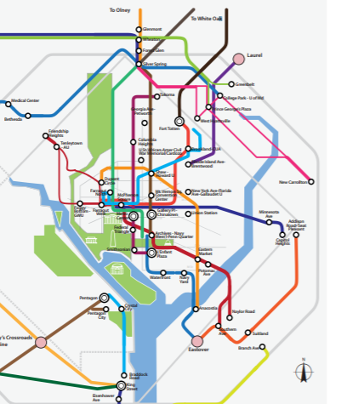
2016 zoning parking reforms
50% reduction in parking required within ½ mile of a Metro station or ¼ mile of major bus route (with RPP restriction);
Multi-family buildings: no requirement for building with 4 or few units; 1 space per 3 units after four units for larger buildings;
Single family dwellings retain 1 space per lot requirement but optional if there is no alley access;
Required parking may be satisfied through off-site or shared arrangements.
Special exception rather than variance for reducing parking
All parking requirements downtown eliminated
WMATA Bus Priority Network

Slide 8
What is parking cash-out?
Parking cash-out is the employer commute benefit practice of converting the value of a parking space subsidized by an employer to a cash benefit for the employee.
In practical terms, it means someone who is offered a free parking space at work is able to flex the cost of the parking space toward another commute option, and keep the remaining cash.
OR

Slide 9
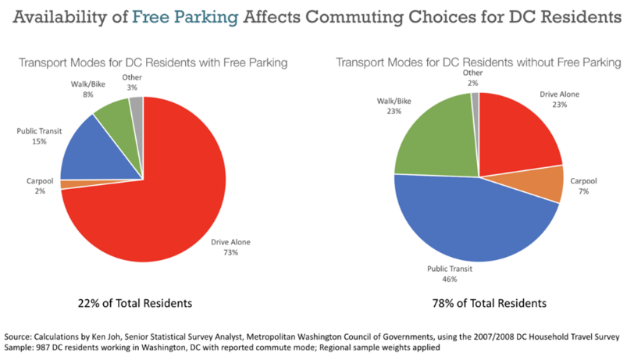
Why parking cash-out is important
22% of commuters are only offered parking benefits
Cash-out results in 10-20% decrease in drive alone commute trips & vehicle miles traveled.

Slide 10
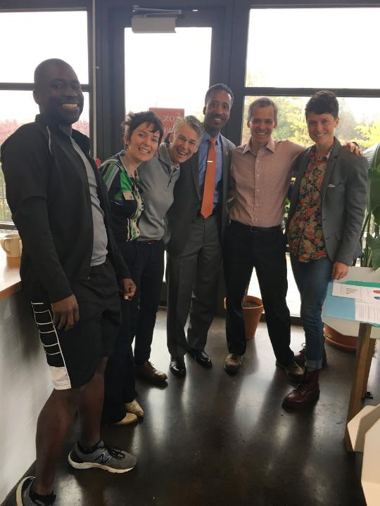
The Campaign (2014-2020)
Sustainable DC Omnibus Act of 2013 includes pre-tax transit benefits
Natural Allies
Expert volunteers
Washington Area Bicyclist Association (WABA)
All Walks DC
DC Sierra Club
Black Women Bike
Bike & Pedestrian Advisory Councils
(Workforce Development groups)
Online survey of our members
Businesses with a sustainability interest
DC Department of Transportation
Education and research on pre-tax transit benefits & parking cash-out from TransitCenter

Slide 11
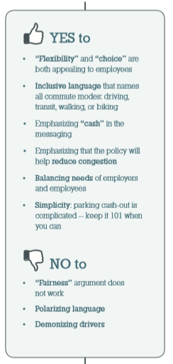
Public Outreach
Focus Group – tested how to talk about the idea of parking cash-out
“Parking cash-out” vs. “flexible commuter benefits”
Inclusive language & choice
Avoid “fairness”
Walk or bike commute benefits are perceived as unfair.

Slide 12
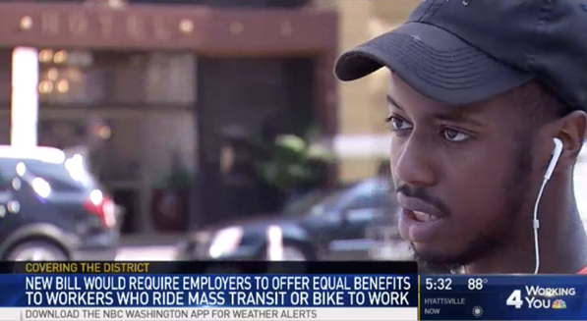
Earned Media
Press release, outreach to local public radio station, TV
Greater Greater Washington blog
Business-sponsored think tank blog hit piece (negative)
DC Policy Center / Yesim Sayin Taylor / JUNE 6, 2017
“The demographics of walking and biking to work tell yet another story of gentrification”
WAMU LOCAL NEWS | MAY 17, 2017
“Sneaker Subsidy? New Proposal Would Give Cash To Commuters Who Don’t Drive”
Greater Greater Washington
“Walk, bike, and transit benefits boost people of all incomes”
By Patrick McAnaney June 13, 2017
WAMU LOCAL NEWS | SEP 25, 2017
“Business Groups Attack D.C.’s Parking Cash-Out Proposal”

Slide 13
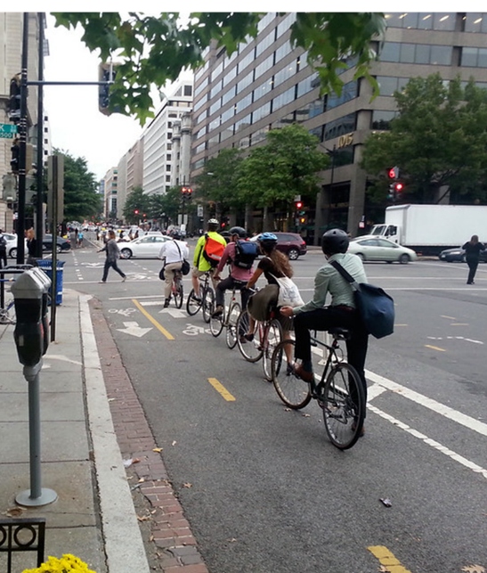
Business Outreach
This is a business regulation
Need employer letters in support (We got 19 letters, 5 testified)
Contact businesses leaders you know
Sustainability professionals (architecture, transportation consultants)
Universities – not friendly despite sustainability interest
Sought role models already doing it – only a few
Interviewed personnel directors
Rush hour on the 15th Street cycletrack. Credit: Beyond DC on Flickr

Slide 14
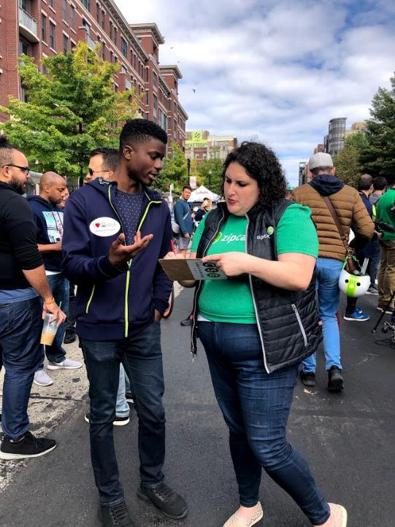
Lobbying the bill
Demonstrate public support for the bill through events, social media, and action alerts
Provide data, graphics, factsheets, responses
Engage legislators and their staff with your allies and their constituents
Continuously work with your legislator champion & key staff
Mobilize & prepare supporters for the hearing

Slide 15
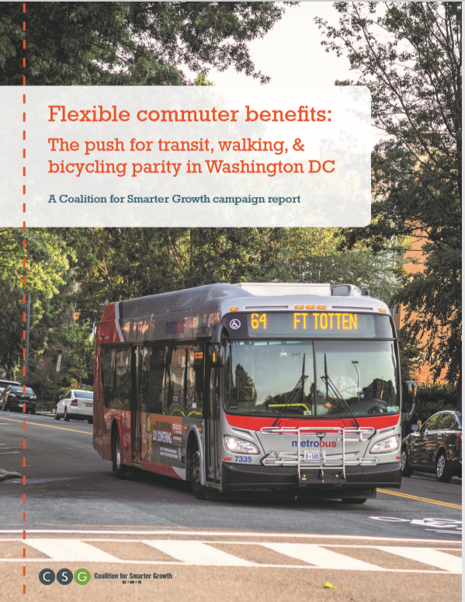
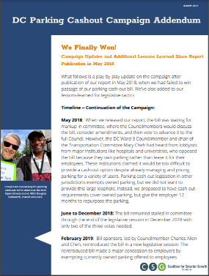
www.smartergrowth.net/ parkingcashout/ Report & Addendum

Slide 16
Questions
Cheryl Cort
Policy Director
Coalition for Smarter Growth
cheryl@smartergrowth.net
www.smartergrowth.net
Notes:
Layout for a concluding slide – potential info to include: thank you’s, contact info, etc.

